Slide 1
Stock price prediction Application
Made by –
Rupesh Sharma(22BTC35156)

Slide 2
Introduction
We made a project for predicting the future prices of a stock by using various machine learning techniques.
What is Machine learning?
Machine learning is a subfield of artificial intelligence (AI) that uses algorithms trained on data sets to create models. These models enable machines to perform tasks that would otherwise only be possible for humans.

Slide 3
So in ML first we have to gather the data to train and test our model after that we can deploy our model to the new data that is unseen to our model.
Stock price predictor application consists following steps - :
Data collection
Data preprocessing and preparation
Selecting right ML model Model Creation
Training model
Evaluating model performance
Deploying model and making prediction Model Deployment
We have divide all these steps in two section -:
Model creation phase
Model Deployment
Now we will explain you all these steps

Slide 4
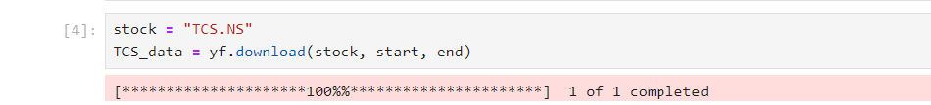
1) Data collection
This steps comes under the model creation phase .we have used yahoo finance library to downloaded the past 7 years data of TCS(Tata consultancy service’s) for creating our model.

Slide 5
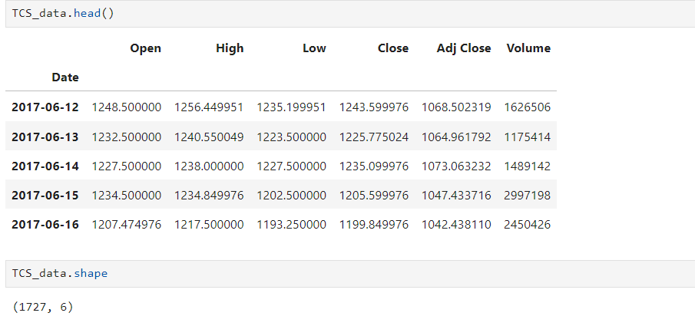
2) Data preprocessing and preparation
This step is very important because if some values in our data are inaccurate and null then it will further effect our model accuracy and can also create error.
Data accuracy is ensured by the yahoo finance it provides real-time data of every stock that is listed in the market. But we also have some methods to check our data we have also implemented these methods

Slide 6
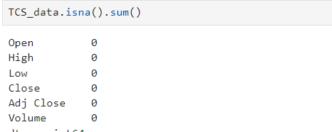
After this we also performed a another step to check if our data is not null/missing of a specific day
You can see that we don’t have values that are null hence no data is missing and inaccurate we have cleaned our data. Now we have to chose one column from the data on which we will perform the further computations for predicting our future price. So, we have two columns that are fulfilling our needs that are – close price , Adjusted close price . We chose adjusted close price because it provides more precise data.
Now We have to also ensure that how many days of data is required to train our model for predicting a specific day data . We have to select amount of data to train our model attentively because if we take a large dataset than our predictions are far than the actual price and if we take short data set than our model will also not able to perform predictions accurately and small up downs in market will cause huge difference in our predicted and original price.

Slide 7
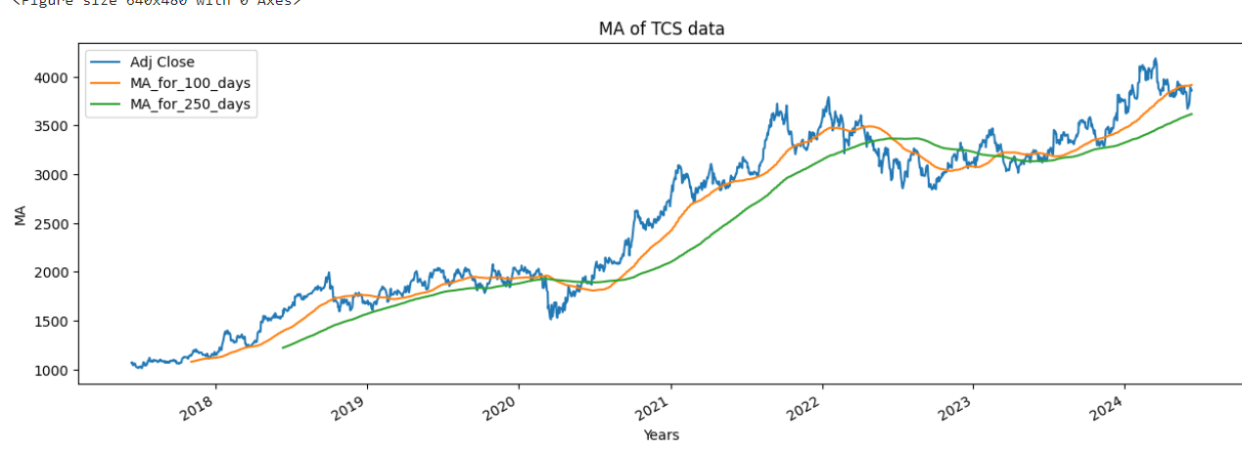
Hence for getting the idea of the input dataset. we have performed some computations of moving average.
Moving average = Sum of the stock price of n number of days
n number of days
Now you can see in the graph that MA of 100 days is close to the actual price hence now we got an idea that how many days data we have to give as input to our model for predicting the next day price

Slide 8
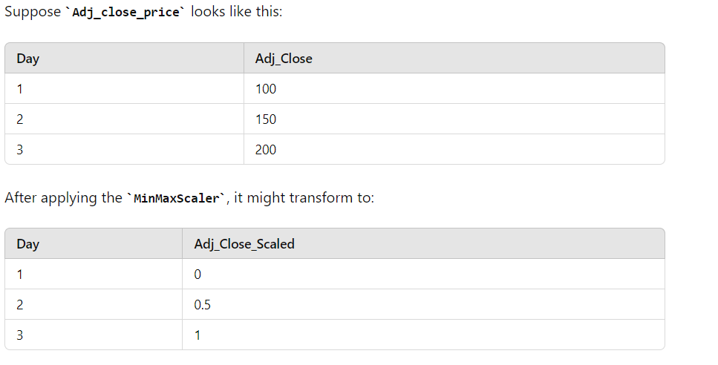
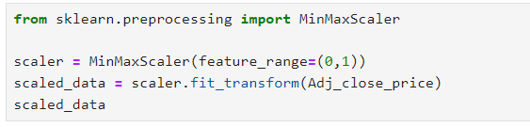
After this we will transform our data b/w 0 to 1 by using Sklearn minmaxscaler. For example –

Slide 9
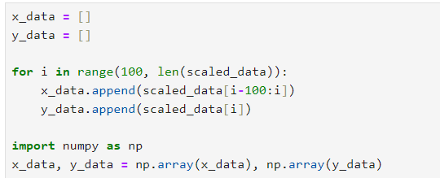
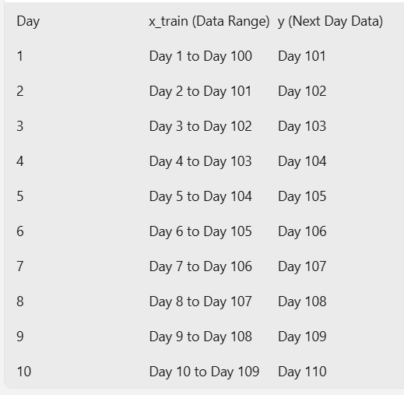
After this we will make 2 arrays from our adjusted closed price to train our model

Slide 10
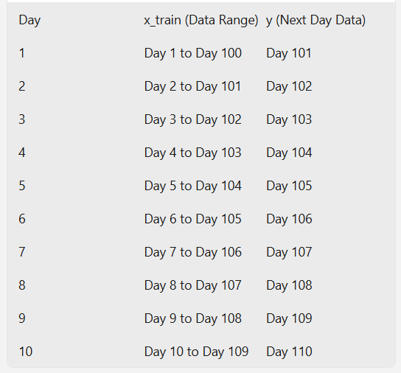
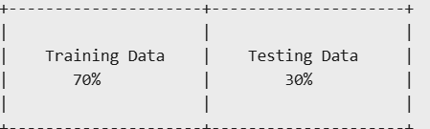
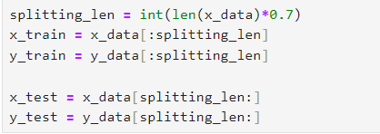
In the last section of this step we divided our data of both the arrays in two parts : training data and testing data

Slide 11
3. Model selection & Creation of models shape
For our project we have used an LSTM (Long Short-Term Memory) model, which is a type of Recurrent Neural Network (RNN). LSTMs are particularly well-suited for sequence prediction problems due to their ability to learn long-term dependencies in data. LSTM are very effective in this type of data because they have the ability to capture long term data sequence.
There are many other models that are also available that can also be used for example – Support vector regression, quadratic regression ,Random forest. Each of these models has its own strengths and weaknesses, and the choice of model depends on the specific characteristics of your data and the nature of the prediction problem.

Slide 12
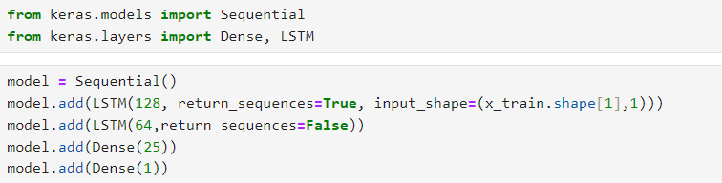
After this we used Keras sequential models to create Design of the model
1. Initialize the Model:
o model = Sequential(): This creates a new sequential model, which is a linear stack of layers.
2. First LSTM Layer:
o model.add(LSTM(128, return_sequences=True, input_shape=(x_train.shape[1],1))): Adds an LSTM layer with 128 units.
▪ return_sequences=True: Ensures that the LSTM layer outputs the full sequence of outputs for the next LSTM layer.
▪ input_shape=(x_train.shape[1], 1): Specifies the shape of the input data (number of time steps, number of features).
3. Second LSTM Layer:
o model.add(LSTM(64, return_sequences=False)): Adds another LSTM layer with 64 units.
▪ return_sequences=False: Outputs only the last output in the sequence, since this is the final LSTM layer.

Slide 13
First Dense Layer:
o model.add(Dense(25)): Adds a fully connected (dense) layer with 25 units. This layer helps in transforming the data from the LSTM layers.
5. Output Dense Layer:
o model.add(Dense(1)): Adds the final fully connected layer

Slide 14
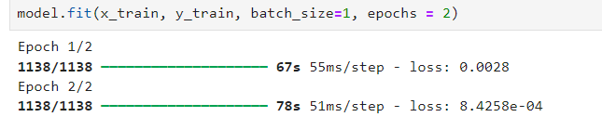

4) Training the model
Here X_train (day 1 to n-100days data),Y_train(day 100 to n days data) are the lables which are given to our model. Batch size = 1 means the model updates its weights after processing each sample, epochs = 2 means the entire process is repeated 2 times.
Now our model is ready to do predictions our training phase is completed success fully. Now we can predict the price of y by using the data set
Once training phase completed then we can do predictions

Slide 15
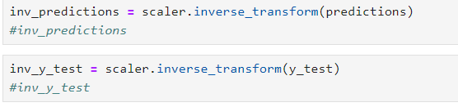
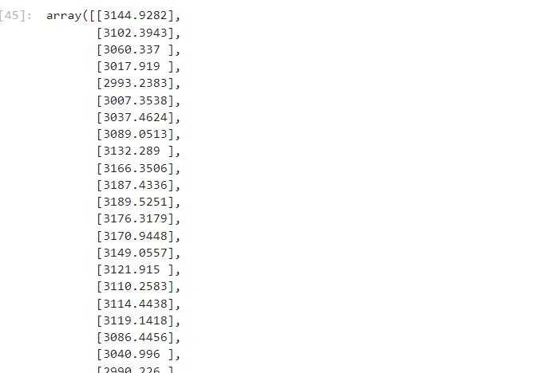
When our predictions are done now its time for again transforming the values from 0,1 form to actual values.

Slide 16
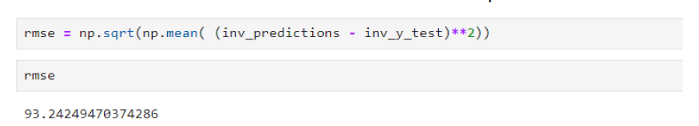
5) Evaluating and testing the performance of the model
First we calculate the errors b/w the actual adj closed price and predicted price. we have different types of error calculation techninques like MAE, MSE and RMSE
Here we used RMSE which is more accurate than other techniques.
So RMSE = 93.24—which means on average the error of a days prediction is loss with 93.24—rupees which is not a large no means our model has not so much errors our model is working perfectly.

Slide 17
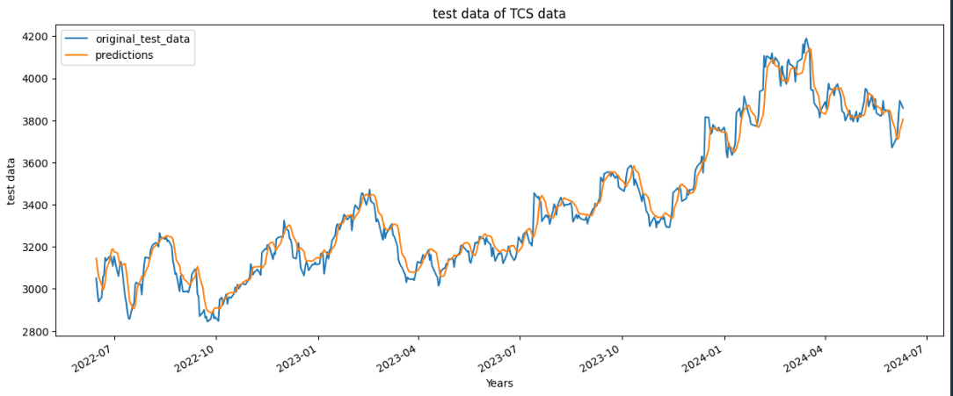
Now we visualized our data on a graph to show the difference between the actual price(test data) and the predicted price.

Slide 18
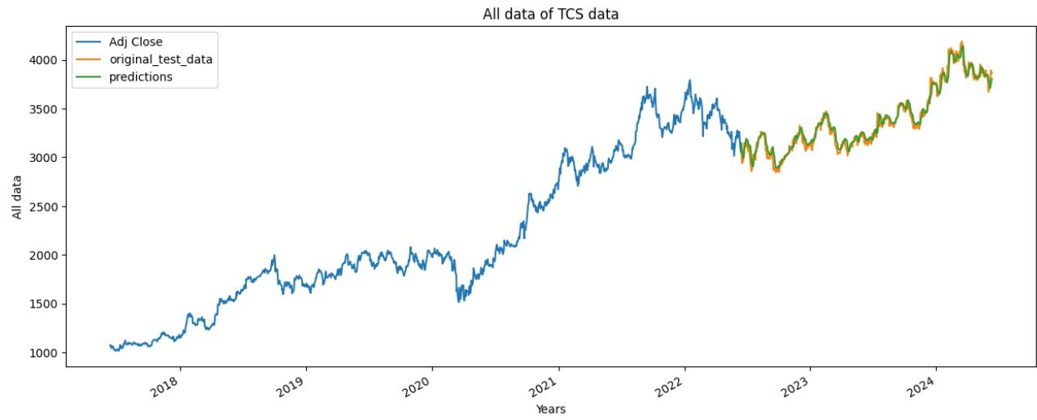
In last we visualized our whole data Training data , Testing data and predicted price in a same graph.

Slide 19
6) Deployment and predictions
Now we have to deploy our model for this first we will save our model after this our model will be saved in the same folder now, our model is created successfully and the next section of model deployment will begin.
For providing better and simple user interface we have used streamlit library and written a 100 line code in which we done predictions by deploying our model in that code.

Slide 20
User interface/Predictions
User has to enter a keyword in to the terminal to execute the code. For Example – Streamlit run “File name”.
After this a new webpage will open on the screen where user has to input stock id, investment amount , No of days price prediction needed.

Slide 21
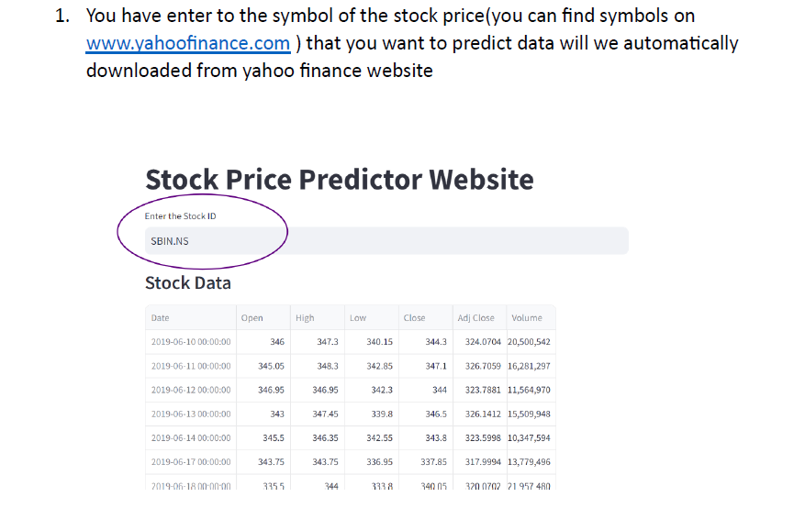

Slide 22
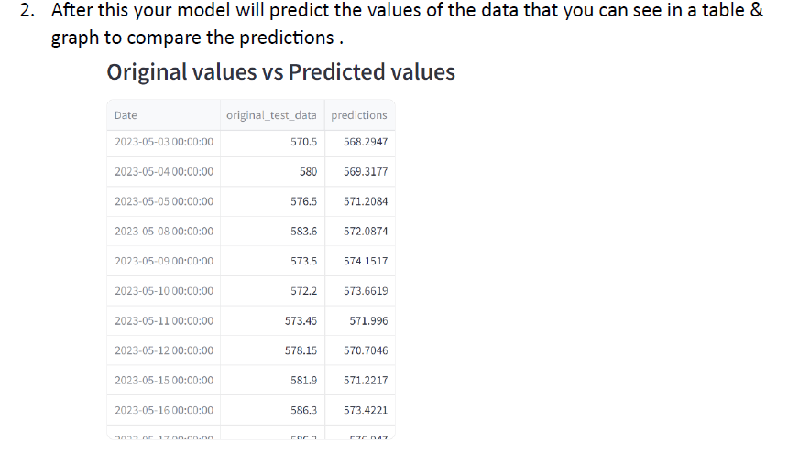
Additionly we have also added some other features like investment amount prediction of loss and profit and next upcoming days stock price forecast

Slide 23
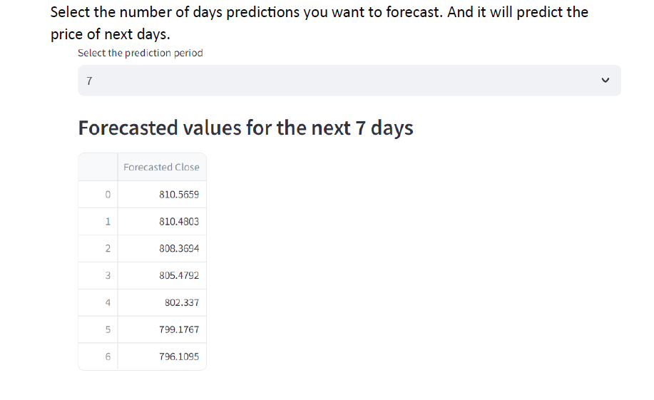
Finally, now we are able to predict our stocks future price by using our model

Slide 24
End of presentation
Thanking you
for Your attention

